Slide 1
WELCOME
TO THE SC CONCEALED WEAPONS PERMIT COURSE
NO FIREARMS OR AMMUNITION IN THE CLASSROOM!

Slide 2
ADMINISTRATIVE ITEMS
POLICY REGARDING AMMUNITION IN THE
CLASSROOM
SECURITY OF FIREARMS
RESTROOMS AND DRINKING FOUNTAINS
TELEPHONES AND EMERGENCY EXITS
POLICY REGARDING REFRESHMENTS/SNACKS
POLICY REGARDING SMOKING
SCHEDULE FOR BREAKS AND LUNCH
AIR CONDITIONING AND HEATING
ADJUSTMENTS
POLICY REGARDING CELL PHONES/PAGERS

Slide 3
COURSE GOAL
TO TEACH THE BASIC KNOWLEDGE RELATING TO THE LEGAL ASPECTS OF SOUTH CAROLINA LAW AS IT PERTAINS TO THE CONCEALED WEAPONS AND CONCEALED WEAPONS PERMITS
AND
THE BASIC KNOWLEDGE, SKILLS AND ATTITUDE NECESSARY FOR OWNING AND USING A PISTOL SAFELY.

Slide 4
Why do you want to carry a concealed weapon??
Do I completely understand the legalities of carrying a concealed weapon?
Am I prepared to alter my daily routine?
What is my plan on when/where/how to use a gun for self-defense?
How much training and/or practice do I need?

Slide 5
LESSON I: PISTOL KNOWLEDGE AND
SAFE GUN HANDLING
LEARNING OBJECTIVES:
STATE THE COURSE GOAL AND ANY SPECIAL
REQUIREMENTS FOR THE LESSONS
IDENTIFY THE PRINCIPAL PARTS OF A PISTOL AND
THE TYPES OF PISTOL ACTIONS, AND DEMONSTRATE
HOW THEY FUNCTION
STATE, EXPLAIN AND APPLY THE NRA RULES FOR
SAFE GUN HANDLING
DEMONSTRATE HOW TO HANDLE A PISTOL IN A SAFE
MANNER

Slide 6
CAUSES OF FIREARM ACCIDENTS
IGNORANCE (LACK OF KNOWLEDGE)
IGNORANCE OF RULES FOR SAFE GUN HANDLING
IGNORANCE OF THE PROPER AND SAFE WAY TO
OPERATE A PISTOL
CARELESSNESS (POOR OR IMPROPER ATTITUDE)
FAILURE TO APPLY THE RULES FOR SAFE GUN
HANDLING
FAILURE TO OBSERVE PROPER PROCEDURES FOR
SAFELY OPERATING A PISTOL

Slide 7
NRA RULES FOR SAFE GUN HANDLING
ALWAYS KEEP THE GUN POINTED IN A
SAFE DIRECTION
ALWAYS KEEP YOUR FINGER OFF THE
TRIGGER UNTIL READY TO SHOOT
ALWAYS KEEP THE GUN UNLOADED
UNTIL READY TO USE

Slide 8
SLED’S FOUR CARDINAL RULES OF FIREARM SAFETY
Treat all firearms as if they are always loaded.
Always point all firearms in a safe direction.
Keep your finger outside the trigger guard until you have decided to fire.
Be sure of your target and what is beyond it.

Slide 9
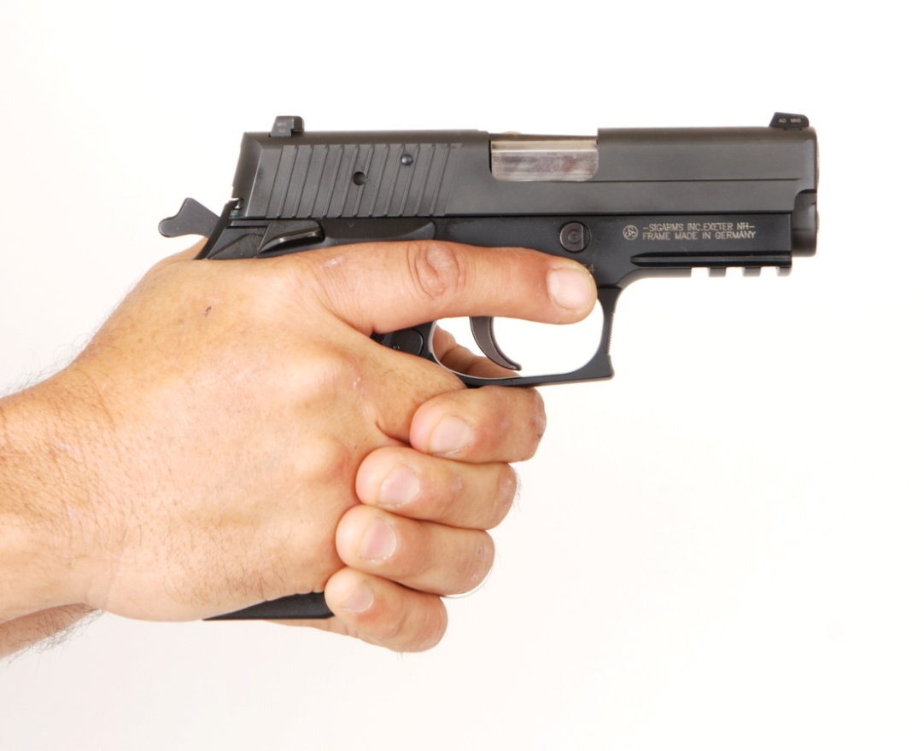
SAFE TRIGGER FINGER POSITION
WITH THE PISTOL POINTED IN A SAFE DIRECTION, THE INDEX FINGER SHOULD BE PLACED ALONGSIDE THE FRAME OF THE PISTOL, ABOVE AND AWAY FROM THE TRIGGER GUARD.

Slide 10
NRA RULES FOR
USING AND STORING A GUN
KNOW YOUR TARGET AND WHAT IS BEYOND
BE SURE THE GUN IS SAFE TO OPERATE
KNOW HOW TO USE THE GUN SAFELY
USE ONLY THE CORRECT AMMUNITION FOR YOUR GUN
WEAR EYE AND EAR PROTECTION AS APPROPRIATE
NEVER USE ALCOHOL OR DRUGS BEFORE OR WHILE SHOOTING
STORE GUNS SO THAT THEY ARE NOT ACCESSIBLE TO
UNAUTHORIZED PERSONS
BE AWARE THAT CERTAIN TYPES OF GUNS AND MANY
SHOOTING ACTIVITIES REQUIRE ADDITIONAL SAFETY
PRECAUTIONS

Slide 11
PISTOL STORAGE
STORE GUNS AND AMMUNITION SO THAT
THEY ARE NOT ACCESSIBLE TO
UNAUTHORIZED PERSONS
STORE GUNS AND AMMUNITION
SEPARATELY
STORE GUNS AND AMMUNITION IN A
COOL, DRY PLACE

Slide 12
COMMON PISTOL ACTION TYPES
SEMI-AUTOMATIC PISTOL
SINGLE-ACTION REVOLVER
DOUBLE-ACTION REVOLVER

Slide 13
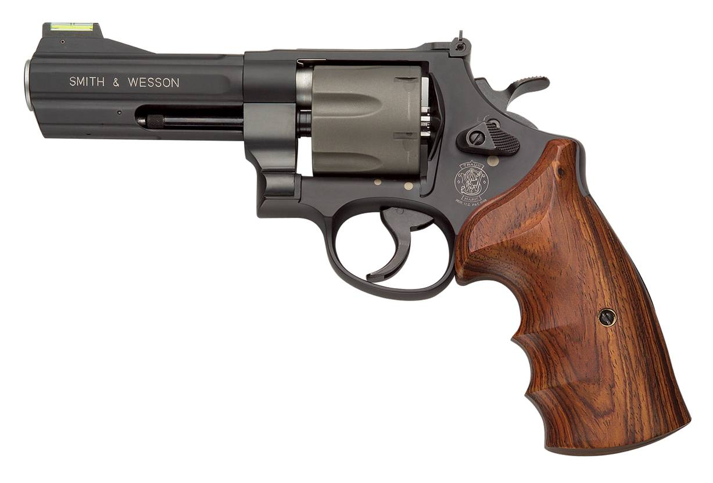
MAIN PARTS OF A REVOLVER
ACTION
(CONTAINED WITHIN FRAME)
FRAME
BARREL
ACTION
BARREL
FRAME

Slide 14

REVOLVER FRAME COMPONENTS
REAR
SIGHT
FRAME
BARREL
ACTION
BACK
STRAP
TRIGGER GUARD
GRIP PANELS
FRONT STRAP

Slide 15
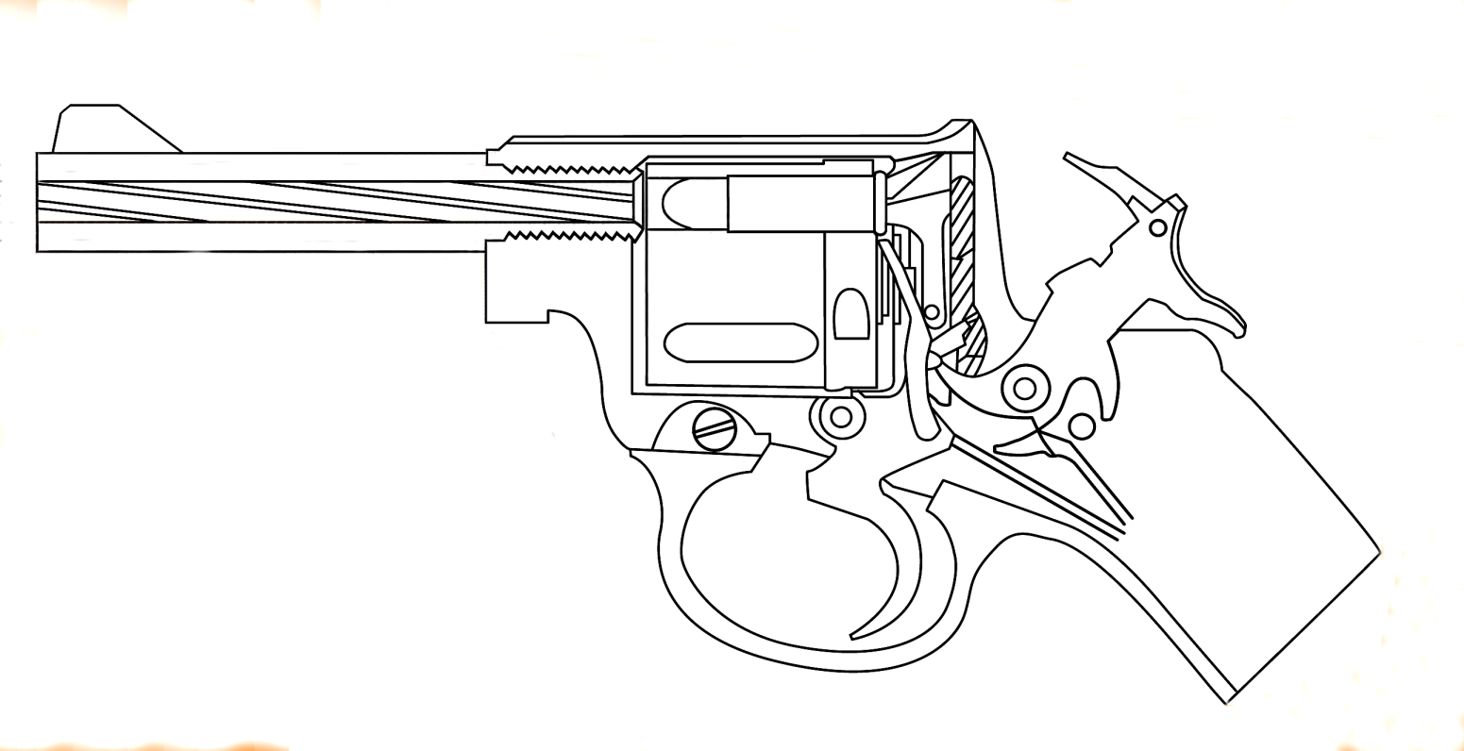
PARTS OF A REVOLVER BARREL
FRONT
SIGHT
CHAMBER
(IN CYLINDER, WITH CARTRIDGE)
RIFLING
(LANDS & GROOVES)
MUZZLE

Slide 16

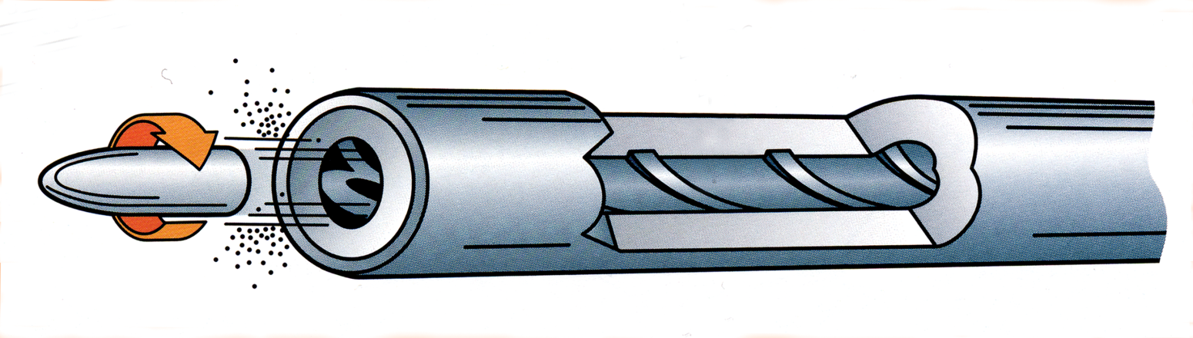
LANDS & GROOVES
RIFLING
SPIRALING LANDS AND GROOVES THAT ENGRAVE THE BULLET AND GIVE IT SPIN AS IT TRAVELS THROUGH THE BORE
LAND
GROOVE
GROOVE
LAND

Slide 17
DOUBLE-ACTION REVOLVER
ACTION PARTS
CYLINDER
HAMMER
HAMMER SPUR
CYLINDER RELEASE LATCH
EJECTOR ROD
TRIGGER

Slide 18
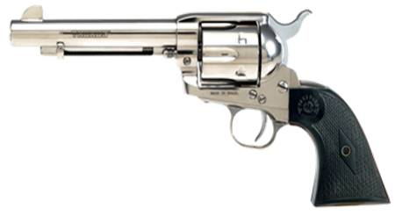
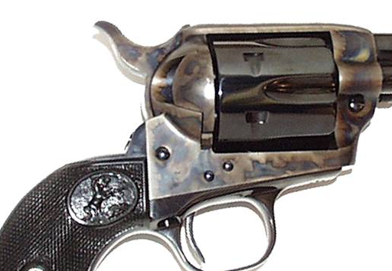
SINGLE-ACTION REVOLVER
ACTION PARTS
EJECTOR ROD
HAMMER
CYLINDER
HAMMER SPUR
LOADING GATE
TRIGGER

Slide 19
SINGLE- AND DOUBLE-ACTION
REVOLVERS
SINGLE-ACTION REVOLVER
THE TRIGGER PERFORMS A SINGLE ACTION: RELEASING THE HAMMER. THE HAMMER MUST BE MANUALLY COCKED FOR EACH SHOT.
DOUBLE-ACTION REVOLVER
THE TRIGGER PERFORMS TWO TASKS: BOTH COCKING AND RELEASING THE HAMMER. MOST DOUBLE-ACTION REVOLVERS CAN ALSO BE FIRED IN THE SINGLE-ACTION MODE.

Slide 20
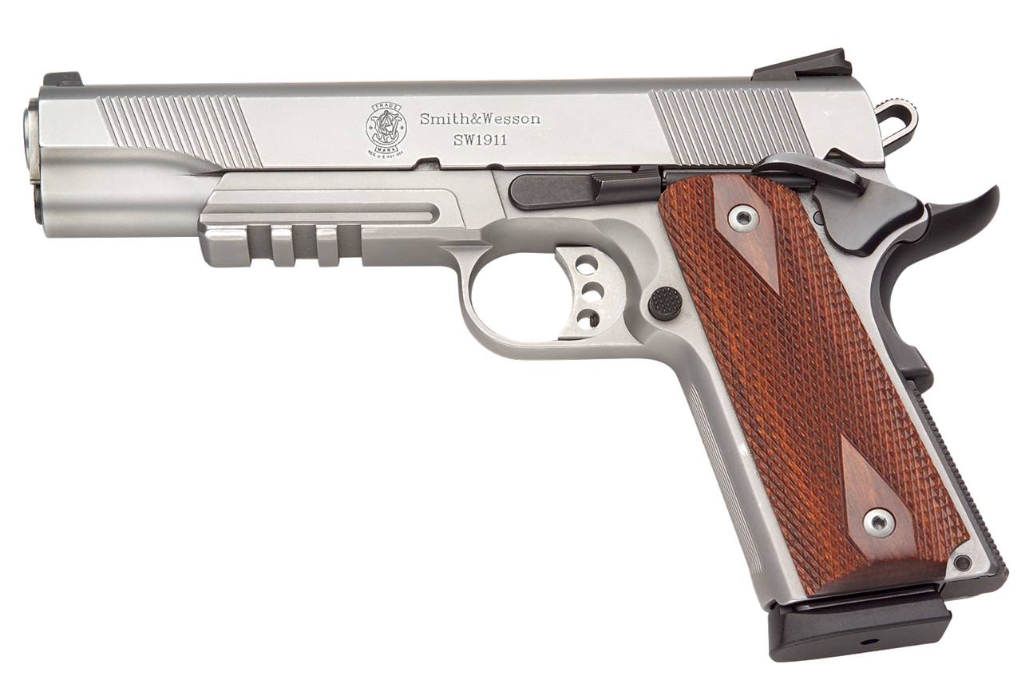
MAIN PARTS OF A
SEMI-AUTOMATIC PISTOL
ACTION
(SLIDE AND PARTS WITHIN FRAME)
BARREL
FRAME

Slide 21
PARTS OF A SEMI-AUTOMATIC
PISTOL FRAME
GRIP PANELS
TRIGGER GUARD
BACKSTRAP
FRONT STRAP

Slide 22
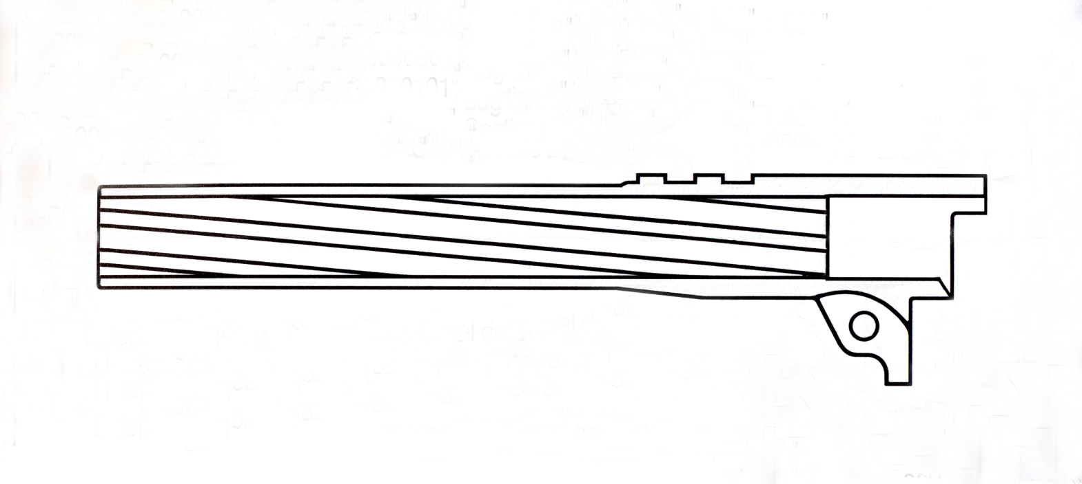
PARTS OF A SEMI-AUTOMATIC
PISTOL BARREL
LOCKING LUGS (ENGAGE RECESSES IN SLIDE)
RIFLING (LANDS & GROOVES)
MUZZLE
CHAMBER

Slide 23
LANDS & GROOVES
RIFLING
SPIRALING LANDS AND GROOVES THAT ENGRAVE THE BULLET AND GIVE IT SPIN AS IT TRAVELS THROUGH THE BORE
LAND
GROOVE
GROOVE
LAND

Slide 24
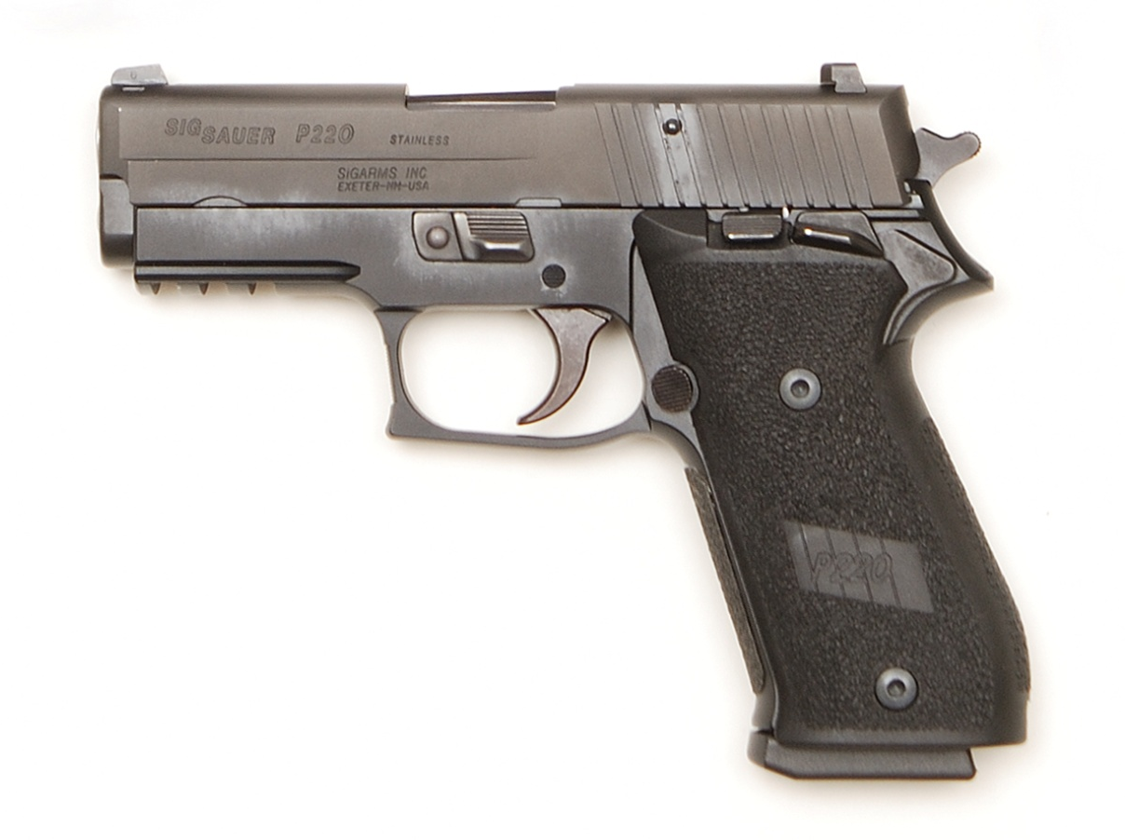
SEMI-AUTOMATIC PISTOL ACTION PARTS
SLIDE
TAKEDOWN LEVER
SLIDE STOP
HAMMER
HAMMER SPUR
SAFETY
TRIGGER
MAGAZINE RELEASE
MAGAZINE

Slide 25
FUNCTIONS OF A
SEMI-AUTOMATIC PISTOL SLIDE
EXTRACTING THE FIRED CASE FROM
THE CHAMBER AND EJECTING IT FROM THE
PISTOL
COCKING THE HAMMER OR FIRING PIN
FEEDING THE TOP CARTRIDGE IN THE
MAGAZINE INTO THE CHAMBER

Slide 26
TYPES OF SEMI-AUTOMATIC
PISTOL ACTIONS
SINGLE-ACTION
EACH PULL OF THE TRIGGER PERFORMS A SINGLE ACTION: RELEASING THE HAMMER. THE HAMMER MUST BE MANUALLY COCKED FOR THE FIRST SHOT.
TRADITIONAL DOUBLE-ACTION
THE INITIAL LONG, HEAVY TRIGGER PULL BOTH COCKS AND RELEASES THE HAMMER. EACH SUBSEQUENT SHOT IS FIRED IN THE SINGLE-ACTION MODE.
DOUBLE-ACTION-ONLY
EACH PULL OF THE TRIGGER BOTH COCKS AND RELEASES THE HAMMER, AS WITH A DOUBLE-ACTION REVOLVER.

Slide 27
LESSON I SUMMARY
CAUSES OF FIREARM ACCIDENTS
SLED 4 CARDINAL RULES FOR SAFE GUN HANDLING
NRA RULES FOR SAFE GUN HANDLING
PISTOL ACTION TYPES
MAIN PARTS OF A PISTOL
PARTS OF A REVOLVER
PARTS OF A SEMI-AUTOMATIC PISTOL
FUNCTIONS OF A SEMI-AUTOMATIC PISTOL SLIDE
TYPES OF SEMI-AUTOMATIC PISTOL ACTIONS

